Slide 1

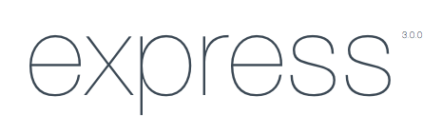
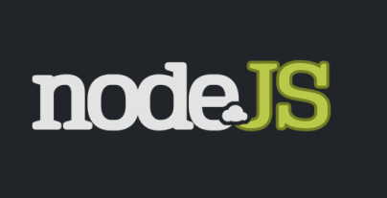
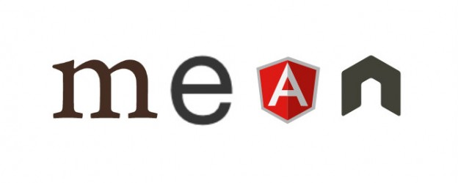
MEAN Stack
Developing "evil" JavaScript applications
Telerik School Academy
Learning & Development
http://academy.telerik.com

Slide 2

Table of Contents
MongoDB
NodeJS
ExpressJS
AngularJS
Templates & Tutorials

Slide 3
MongoDB

Slide 4
MongoDB
MongoDB:
NoSQL Database
Document based
Can be easily used with Node
Get it from http://www.mongodb.org/
Mongoose - http://mongoosejs.com/ or NPM

Slide 5

NodeJS

Slide 6
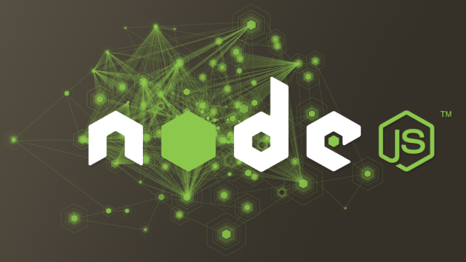
NodeJS
NodeJS
JavaScript based server
Asynchronous and event driven
Easy to learn and write
Comes with package manager (NPM)
Get it from http://nodejs.org/

Slide 7
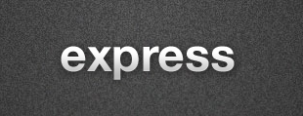
ExpressJS

Slide 8
ExpressJS
ExpressJS
MV* Framework for NodeJS
Easy routing of requests
Modularity for the server
Get it from http://expressjs.com/ or NPM

Slide 9

AngularJS

Slide 10
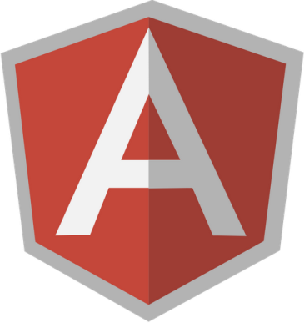
AngularJS
AngularJS
MV* Framework for the client
Contains everything but the kitchen sink
Modularity, templates, routing, SPA, etc
Get it from http://angularjs.org/ or NPM

Slide 11
Templates & Tutorials

Slide 12
Templates & Tutorials
Templates
http://www.mean.io/
http://meanjs.org/
Tutorials
http://scotch.io/
http://www.thinkster.io/angularjs/GUIDJbpIie/angularjs-tutorial-learn-to-build-modern-web-apps
http://www.ibm.com/developerworks/library/wa-nodejs-polling-app/

Slide 13
NodeJS Web Server
http://academy.telerik.com

Slide 14
Exercises
Create a web site using MEAN. You can use one of the templates or create your own:
Try to use good project architecture
Use at least 5 routes
Have authentication and authorization
Have details page for an entity
Have create, update pages
Have admin panel with full CRUD

